Slide 1
Digital Thermometer
(Using LM34)
Lab #4
By Socheath, Sok

Slide 2
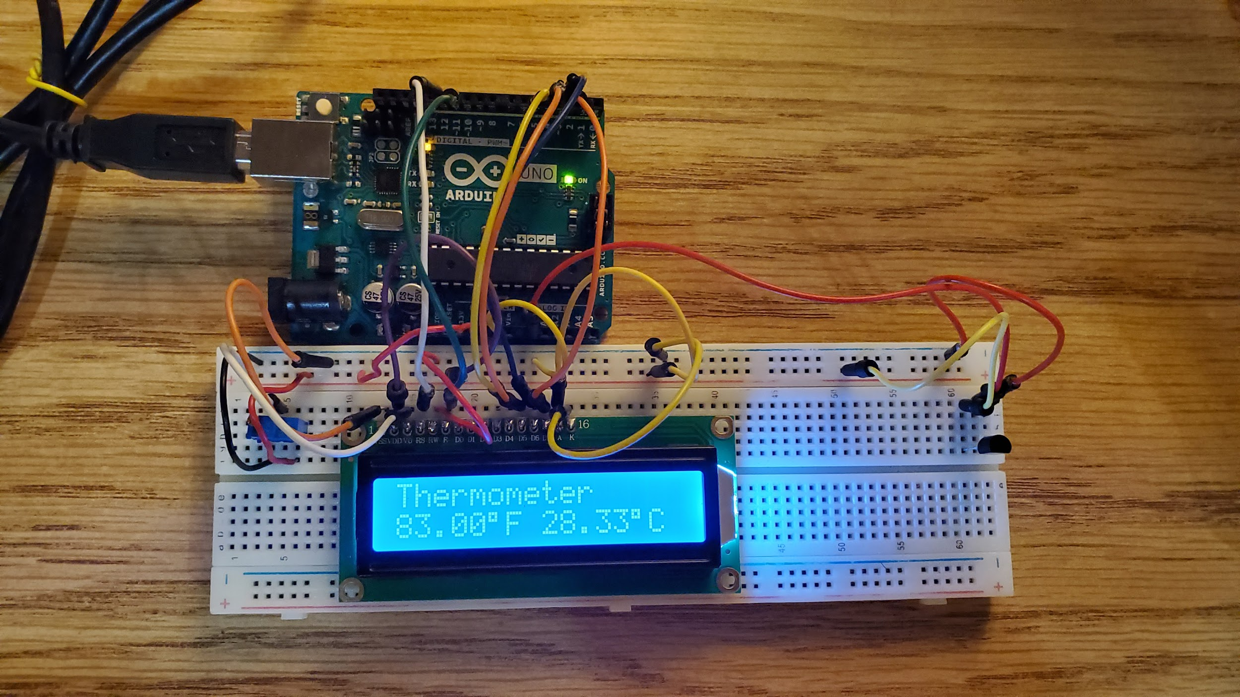

Slide 3
Overview
Background Information
Measurement
LM34
Unit Conversions
Schematic
Demo

Slide 4
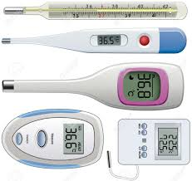
Digital Thermometer
instrument for measuring the temperature of a system
easily portable
convenient digital display
Can be used in 3 ways:
Oral (in the mouth).
Rectal (in the bottom).
Axillary (under the arm).
[1]

Slide 5
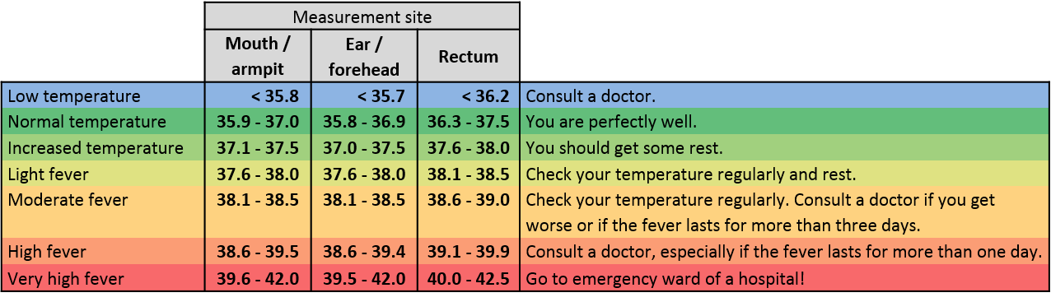
Measurement
Thermometers measure temperatures in degrees
Using the Celsius or Fahrenheit system.
A fever is a rise in body temperature and it is usually a sign of infection.
[1]

Slide 6
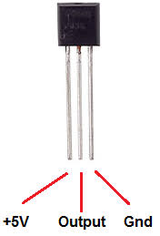
LM34 DZ : Temperature Sensor
Output Type: Analog Voltage
Output Current: 10 mA
Measurement: Fahrenheit
Range: −50° to 300°F
Gain: 10 mV/°F
Accuracy: +/- 4°F
Operates From 5 to 30 Volts
Low self-heating and Low-impedance output
[3]
Notes:
keep out the noise out of the circuit and maintain a stable output voltage,linear monolithic

Slide 7
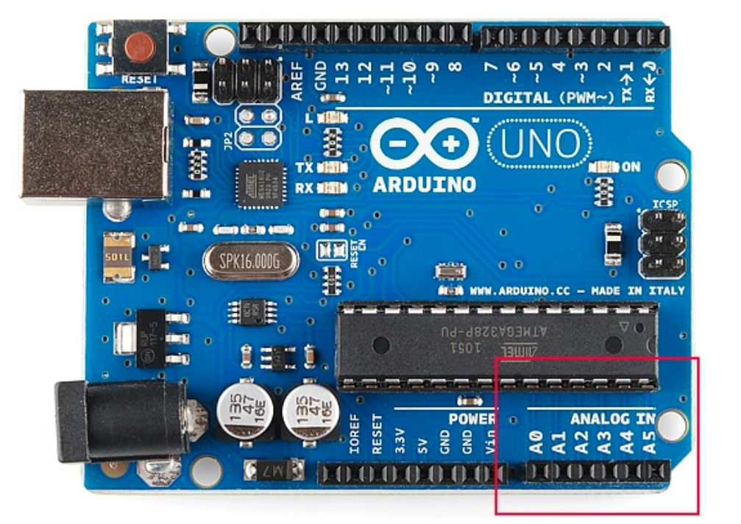
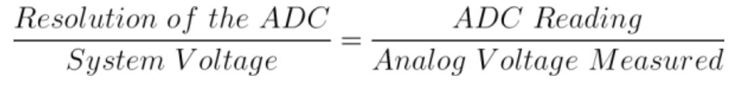
ADC to Voltage Conversion
ADC on the Arduino: 10-bit
Can detect 1,024 (2^10) discrete analog levels
System voltage: 5 V
[2]

Slide 8
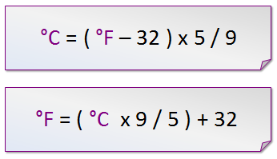
Fahrenheit to Celsius Conversion
Linear Scale Factor: 10.0 mV/°F
°F = (Analog Voltage * 1000)/ 10
[4]

Slide 9
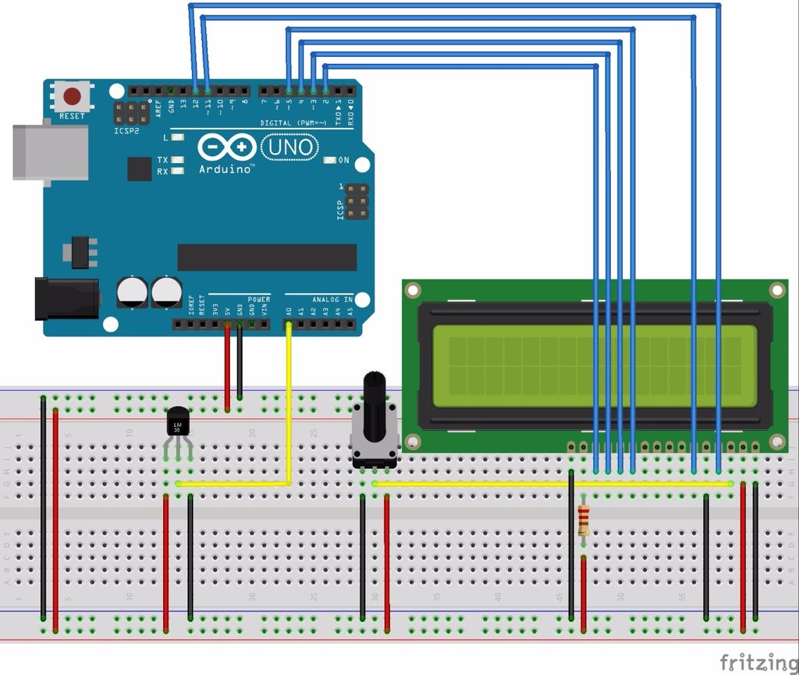
Schematic
[4]

Slide 10
Limitation and and improvement,
Low sensitivity
Big time constant
Limited information
Unstable connection
Use a different sensor
Solder everything together
Focus of portability and ergonomic o make the prototype more marketable

Slide 11
[1] “How To Use A Thermometer To Take Your Temperature.” Cleveland Clinic,
https://my.clevelandclinic.org/health/articles/9959-thermometers-how-to-take-your-temperature.
[2] Analog to Digital Conversion, https://learn.sparkfun.com/tutorials/analog-to-digital-conversion/all.
[3] “LM34DZ/NOPB Texas Instruments: Mouser.” Mouser Electronics,
https://www.mouser.com/ProductDetail/Texas-Instruments/LM34DZ-NOPB?qs=QbsRYf82W3FAYTNXNU2hKA==.
[4] Bruni, Carlos, et al. “Guide for LM35, LM335 and LM34 Temperature Sensors with Arduino.” Random
Nerd Tutorials, 15 July 2019, https://randomnerdtutorials.com/arduino-lm35-lm335-lm34-temperature-sensor/.
References

